Slide 1
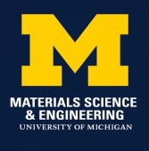
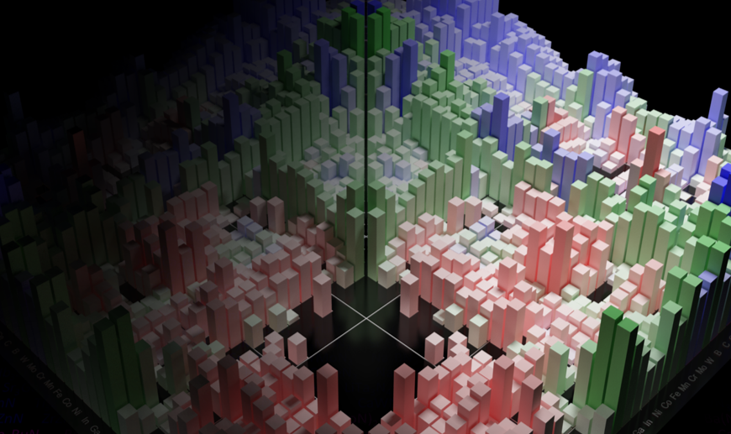
MSE 593 Data-Driven Materials Design and Genomics
Data-Driven Computational Materials Design:
Lecture 2: Materials Project and Pymatgen
Professor Wenhao Sun whsun@umich.edu
2023 Hokkaido Summer School
Notes:
Syllabus Wenhao Sun
Set up Canvas – Katsuyo
Google Survey – Katusyo

Slide 2
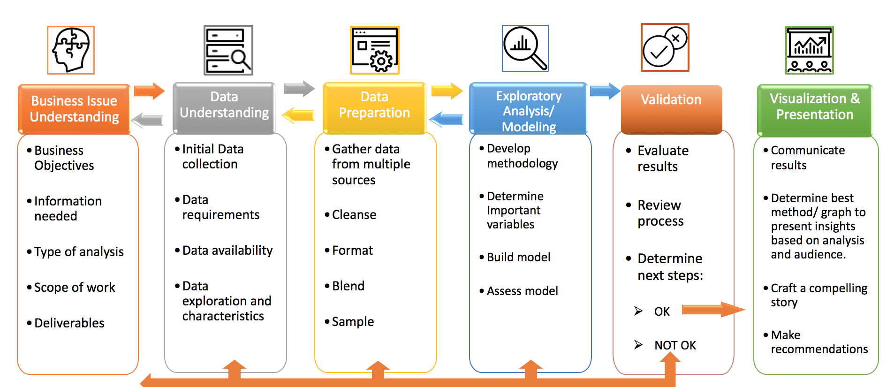
Cross-Industry Standard Process for Data Mining
(CRISP-DM)
Materials
Lecture 2

Slide 3

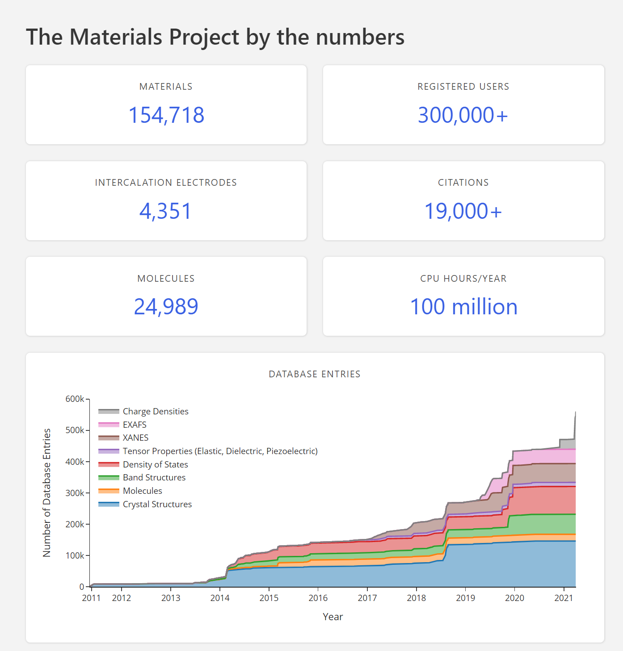

Slide 4
A tour of the MaterialsProject
Go to www.materialsproject.org
Create an account
Explore Fe
Explore GaN
Explore others
Explore Crystal Toolkit
Important Aspects
Navigating search results
Crystal Structure in DFT
E_above_hull
mp-id

Slide 5
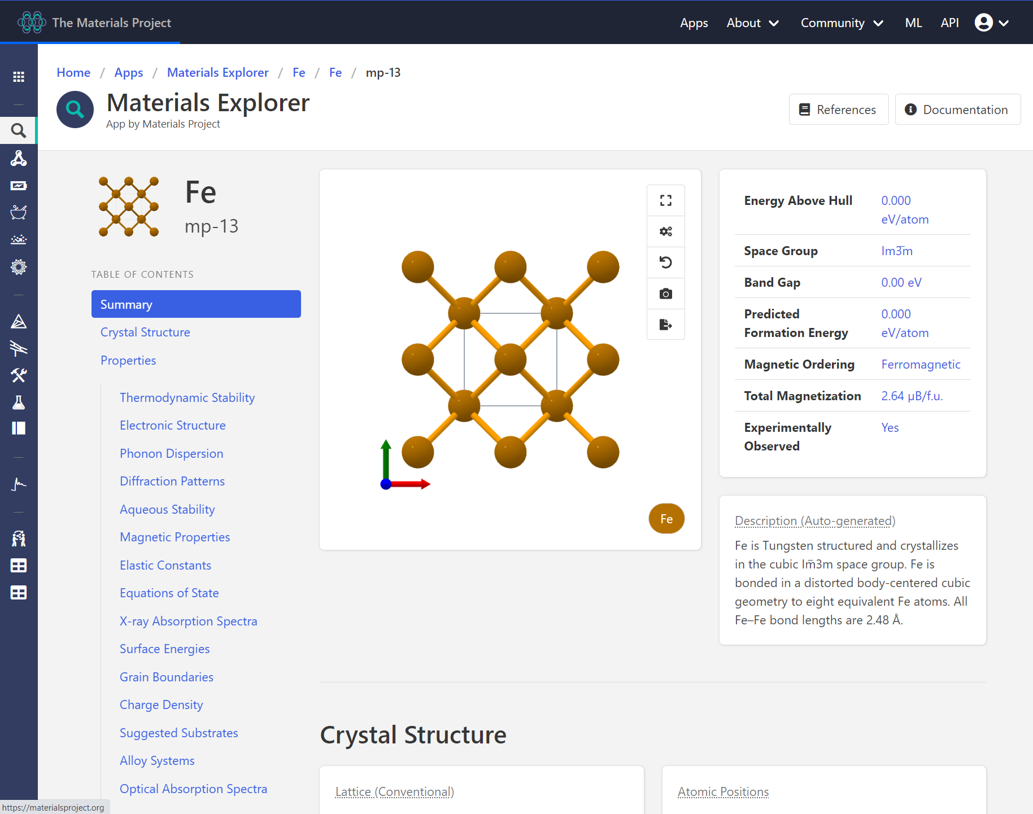
Lots of things to explore!

Slide 6
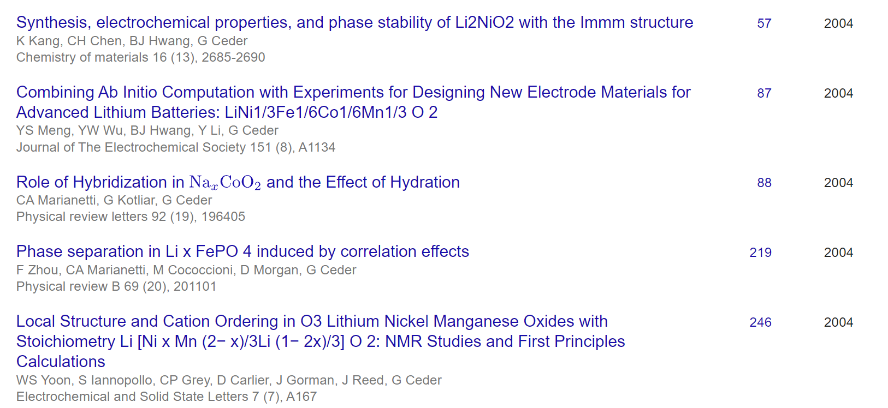
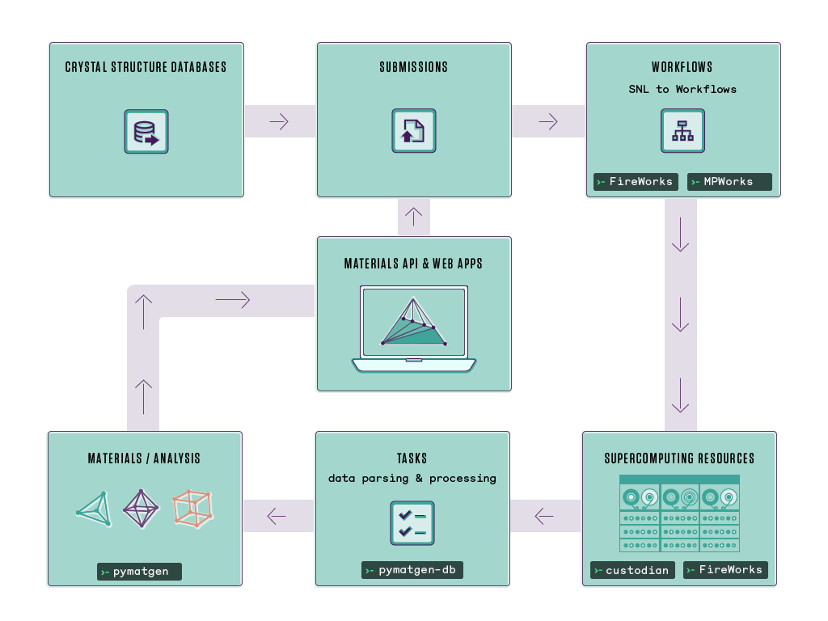
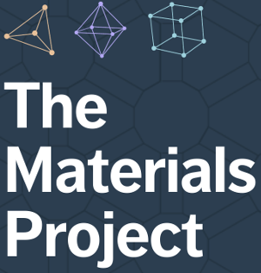
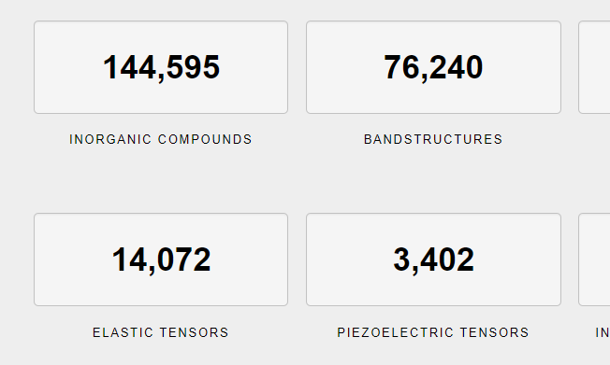
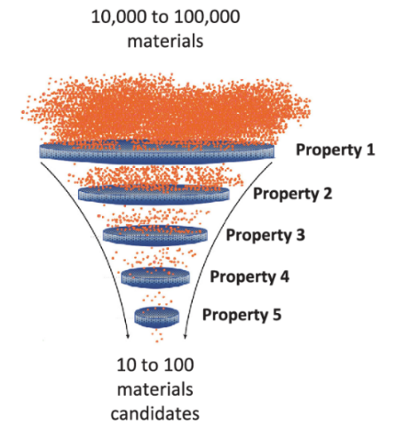
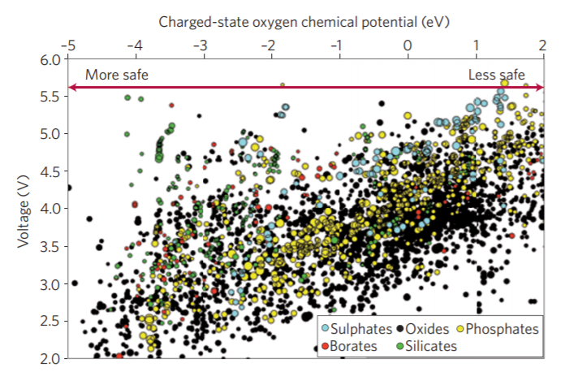
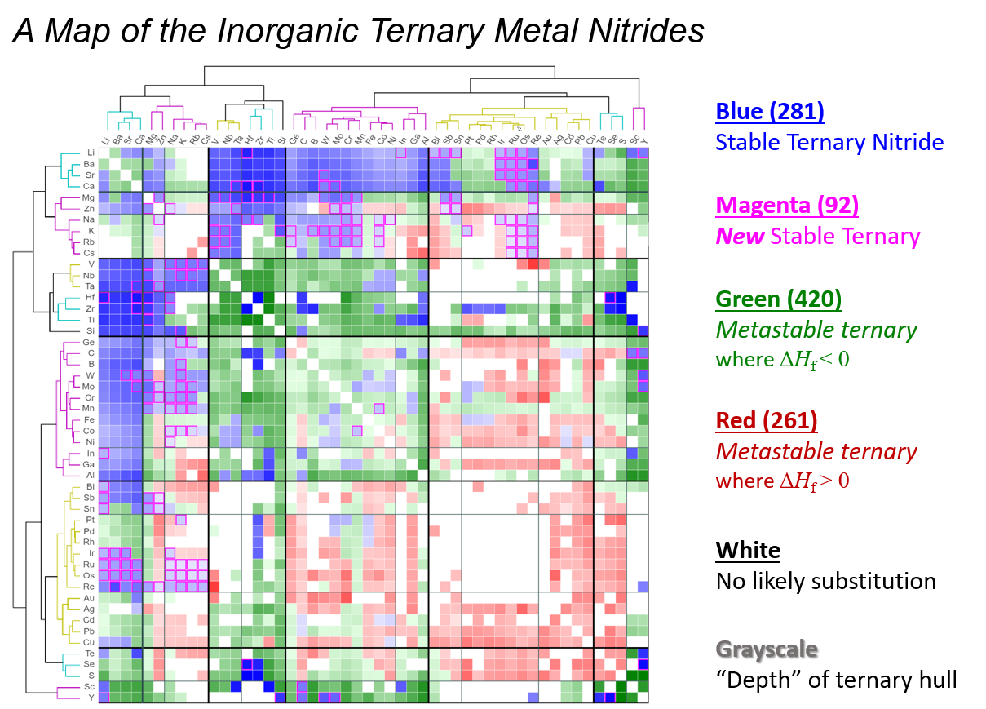
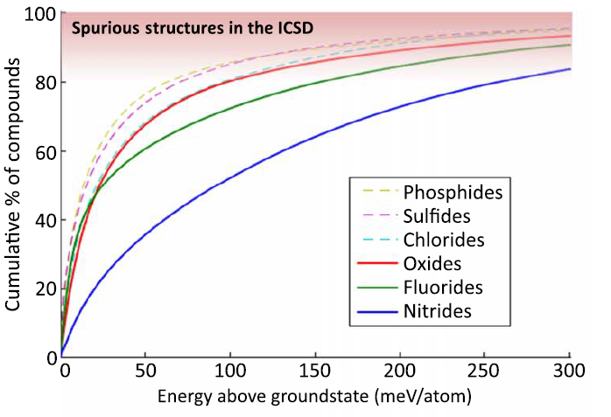
Before 2010 – DFT studies on single materials systems
2011 – Materials Genome Initiative, Materials Project
For Loop
Today
It’s not just ‘more’ data, you can do a different kind of science:
1400 data points
30,000 data points
6,000 data points
Materials Search
Fast prototyping and Broad hypothesis testing
Quantitative statistics
Visualize broad chemical trends

Slide 7
Density Functional Theory is a
first-principles
atomistic theory
that can approximately calculate
the energy and electronic structure
of a unit cell with periodic boundary conditions
of generally fewer than 100 atoms

Slide 8
Kinetic Energy
External Potential
e⁻ - e⁻ Interaction
TOO EXPENSIVE!
Can only solve about 10 Electrons = 1 Atom of Neon

Slide 9
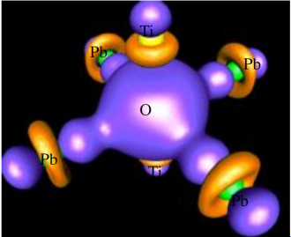
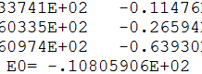
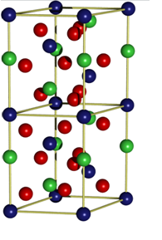
Electron Density
n(R)
Energy of System
E₀
Sort of …
External Potential
(Crystal Structure + Number of e⁻)

Slide 10
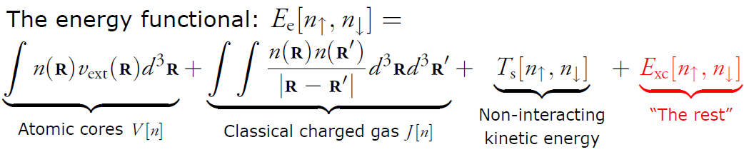
Approximations for E[n(R)]
Functional | Local Density Approx. (LDA) | Generalized Gradient (GGA) | Hybrid (B3LYP, HSE)
Approximation | Constant Electron Density | Gradient Electron Density | GGA + Exact XC
Energy Errors | ± 10 kJ/mol | ± 10 kJ/mol | ± 3 kJ/mol
Band Gap | 40-100% Under | 40-100% Under | ± 10%
Band Structure | 15% Error | 15% Error | 1% Error
Computational Cost | Good | Good | 100x GGA/LDA

Slide 11
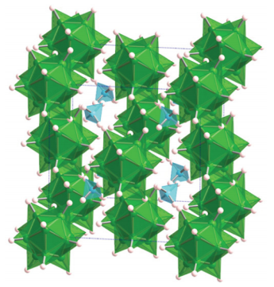
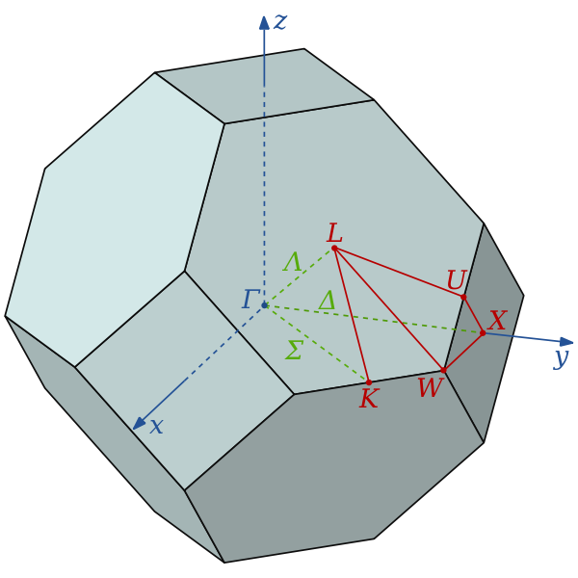
Practical Considerations for DFT
Unit Cell
w/ Periodic Boundaries
Calculation Parameters
Convergence vs. Computational Cost
Parameters
# of K-points
Energy cutoff for Basis Functions
Functional Used
Bulk: Crystal Structure
Supercell: minimize short-range effects
Precision costs time
Computer Time scales as O(n³)
S.E.C = Standard Energy Calculation
Band Structure = 2-3 x S.E.C
Magnetic Calculation = 5-10 x S.E.C.
High Precision HSE = 100 x S.E.C.
2 atoms : 10 seconds on 1 CPU
80 atoms : 18 hours on 16 CPUs
1000 atoms : 1 month on 1000 CPUs

Slide 12
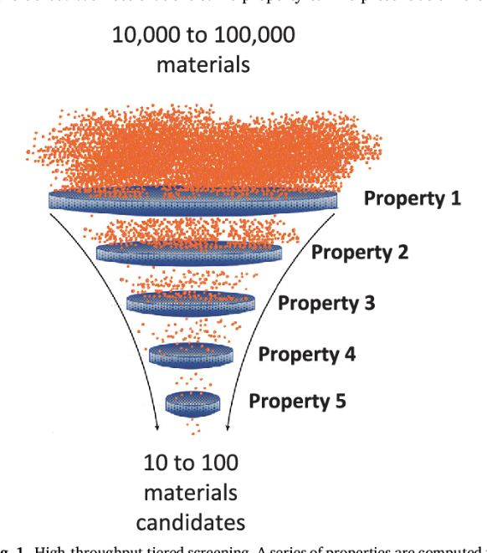
DFT in Computational Materials Design
DFT Inputs
DFT Outputs
→ Parameters for
Multiscale Modeling →
Phase Stability
Formation Energies
Vibrational entropies
Reaction Energies
Band Structure
Band Gap,
Effective Mass
Dielectric constant
Defect Energies
Surface energies
Dislocation energies
Mechanical Properties
Elastic Tensors
Gruneisen Parameter
Speed of sound
Transport Properties
Diffusion constants
Structure →
Property Screen
Crystal Structure
Known structures:
(ICSD) Inorganic Crystal
Structure Database
New Structures:
Chemical substitutions
Crystal structure prediction
Defect Structures:
Slabs, Vacancies, Dislocations
Strained, Distorted

Slide 13
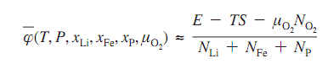
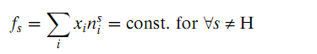
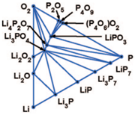
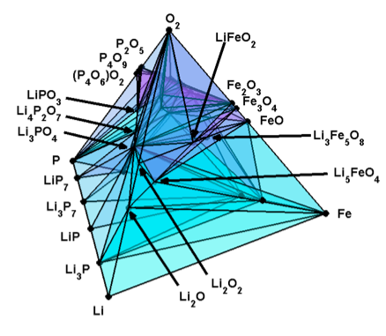
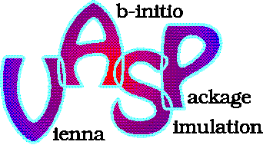
Thermodynamics
Crystal Structure Prediction
Phase Diagrams + Reactions
AgAu₂F₈, BaFe₂Br₈, BaFe₂Br₈, BaMn₂O₈, BaTm₂F₈, BeB₂H₈, BeB₂H₈, CaB₂F₈, , CdAl₂Cl₈, CdAu₂F₈, CeSe₂O₈, CoAl₂Cl₈, CoCl₂O₈, CuAl₂Cl₈, CuAl₂Cl₈_p1, CuAl₂Cl₈, CuGa₂Cl₈, HfMo₂O₈, HgAu₂F₈, MgAl₂Cl₈, MgAu₂F₈, MnB₂F₈, MoU₂O₈, MoV₂O₈, MoV₂O₈, NiAu₂F₈, NiAu₂F₈, NiAu₂F₈, NiCl₂O₈, PdAl₂Cl₈, PdAu₂F₈, PdAu₂F₈, PdGa₂Br₈, PdGa₂I₈, …etc etc
Lowest Energy Structure is the Winner!

Slide 14
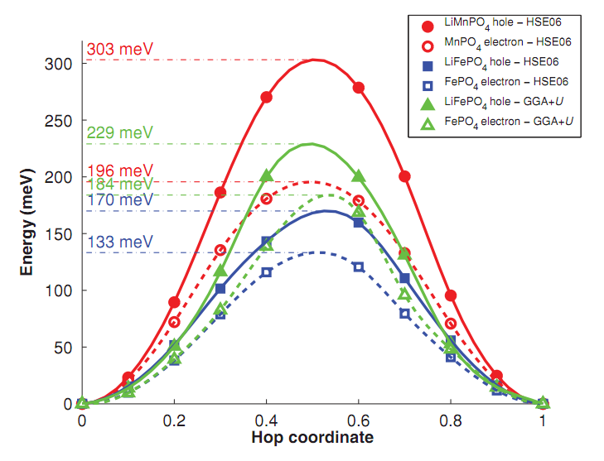
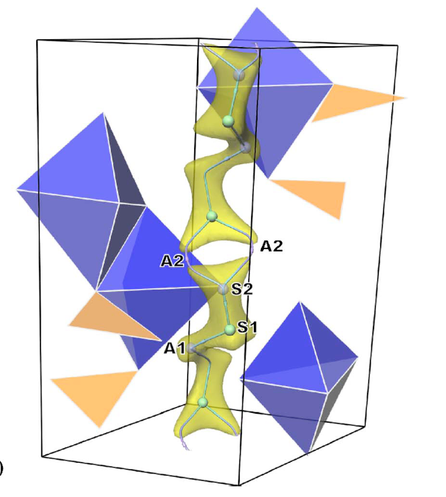
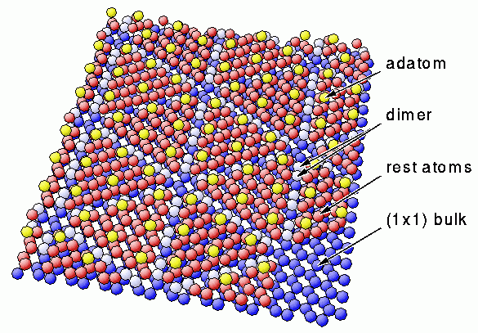
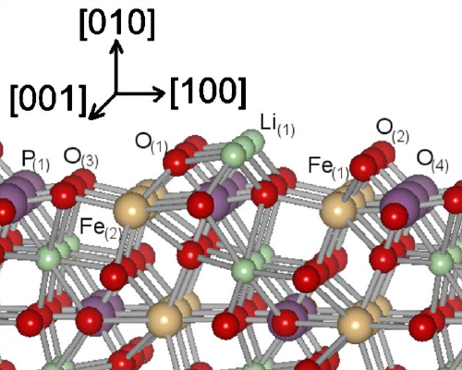
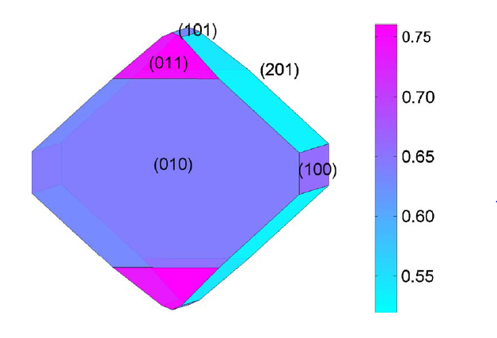
Kinetics
Diffusion Energy Barriers – Diffusion Paths
Surface Energies, Surface Reconstructions, Nanoparticle Morphologies

Slide 15
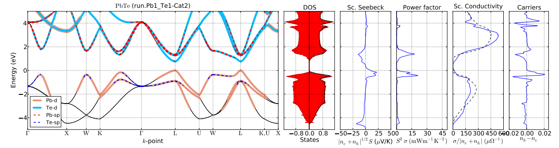
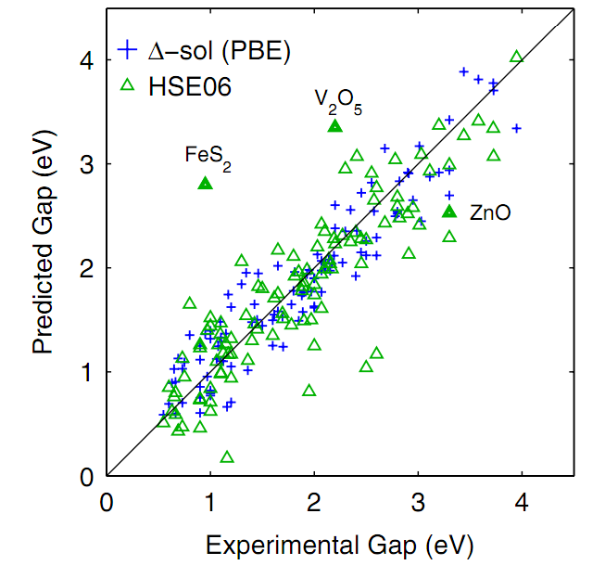
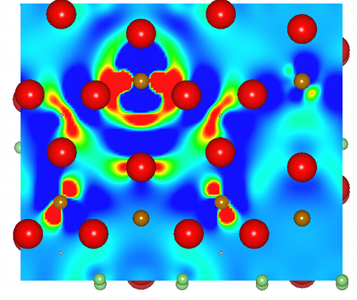
Electronic Structure

Slide 16
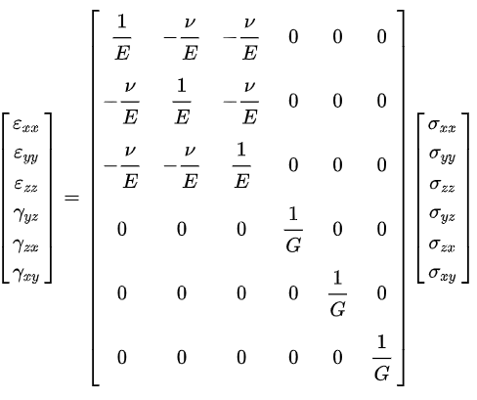
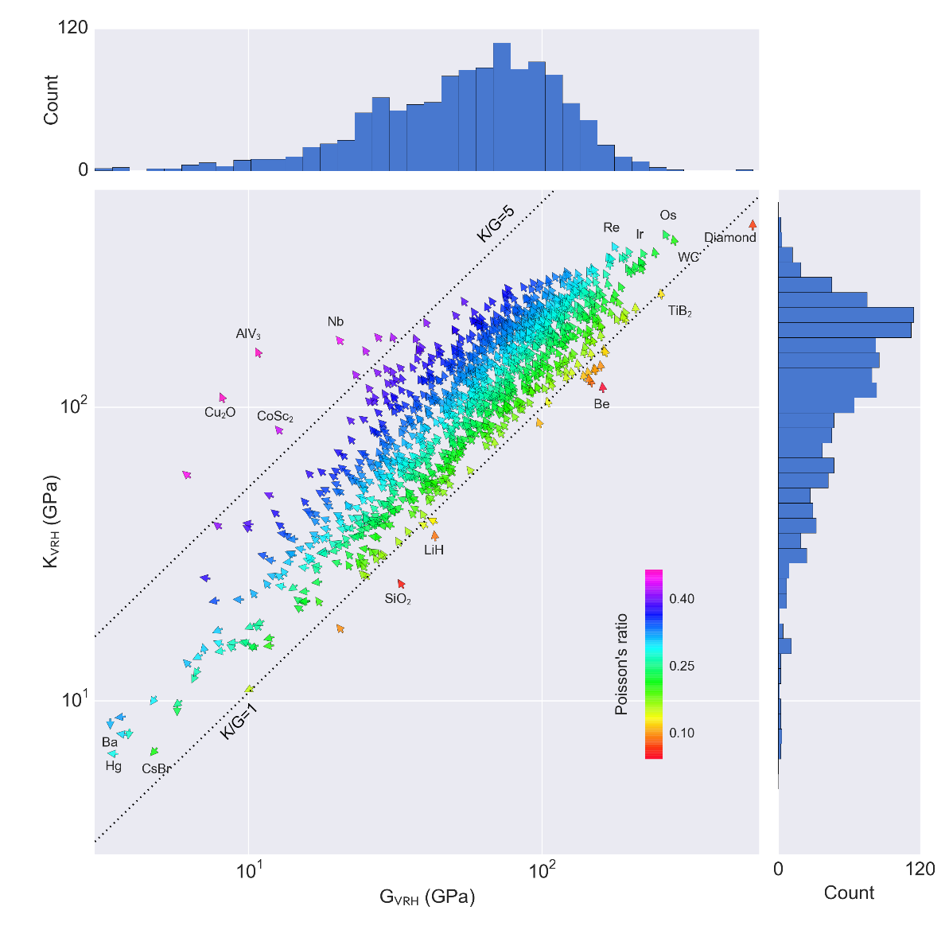
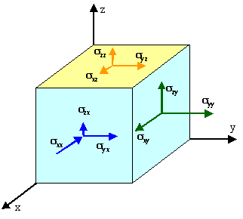
Mechanical Properties

Slide 17
Density Functional Theory is a
first-principles
atomistic theory
that can approximately calculate
the energy and electronic structure
of a unit cell with periodic boundary conditions
of generally fewer than 100 atoms

Slide 18
Computational MSE spans multi-hierarchical length and time scales
Continuum: Stress-strain curve, Fracture, Deformation
Phase Field: Microstructural evolution
Nucleation, growth, diffusion
Calphad: Phase Diagram
Processing guidance
DFT
Input:
Chemistry
Crystal Structure
Output:
Formation energies
Elastic Constant
Thermal Expansion

Slide 19
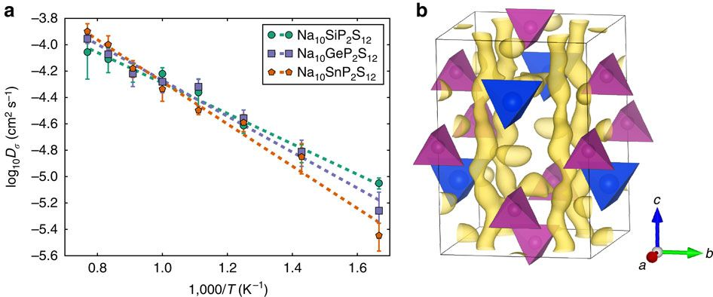
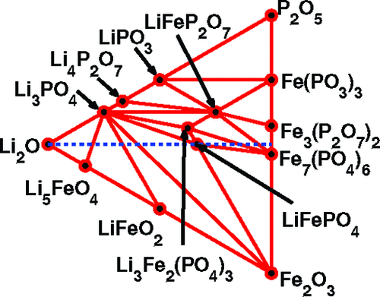
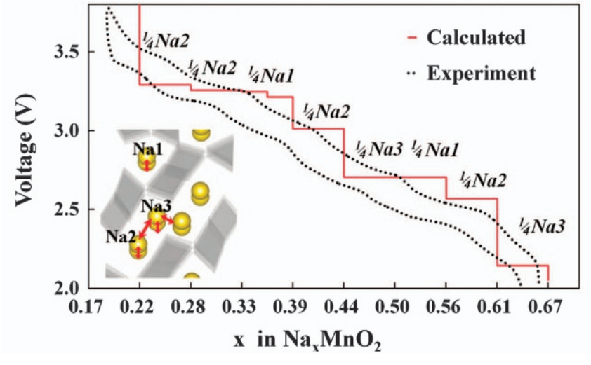
Phase Field:
Thermal and Cycling Stress in Solid-State Battery Cathode
Molecular Dynamics: Lithium diffusion barriers
Li-conductivity pathways
DFT
Voltage Curves
Phase Stability
Crystal Structure

Slide 20
LENGTH SCALES AND APPLICATIONS
 | Approx. Scale (m) | Example | Example Models
Macroscopic | > 10⁻³ | Behavior of components & devices | Finite Element Analysis (FEA), computational thermo
Mesoscopic | 10⁻⁶ - 10⁻³ | Polycrystals and their properties | FEA, phase field modeling, computational kinetics
Microscopic | 10⁻⁷ – 10⁻⁴ | Microstructure within a single crystal | Phase field modeling, computational kinetics, dislocation dynamics
Atomic | 10⁻⁹ - 10⁻⁶ | Fundamental mechanism for transport, deformation, etc. | Molecular dynamics
Quantum | 10⁻¹¹ - 10⁻⁸ | Electronic structures, elastic constants, energetics | Density functional theory

Slide 21
Cross-Industry Standard Process for Data Mining
(CRISP-DM)
Materials
Gathering Data from Materials Project

Slide 22
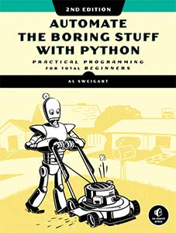
Your Coding Experience? Python?
Data types (string, float, int, bool)
Print
If then, Boolean Operators (And, Not, Or)
For loop, While loop
Functions (modules)
Data structures: List, Dictionary
Plotting (Matplotlib)
Object-oriented programming?
Great Python
Introduction!

Slide 23
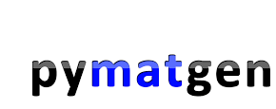
Materials Project is a database
Application Programming Interface (API) is a query-engine for the data
Pymatgen is a python package to manipulate MP data

Slide 24
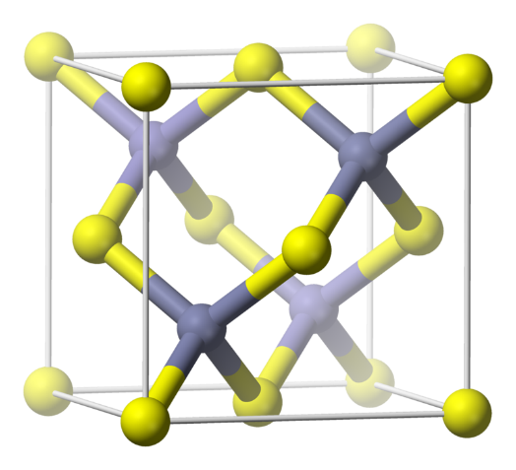
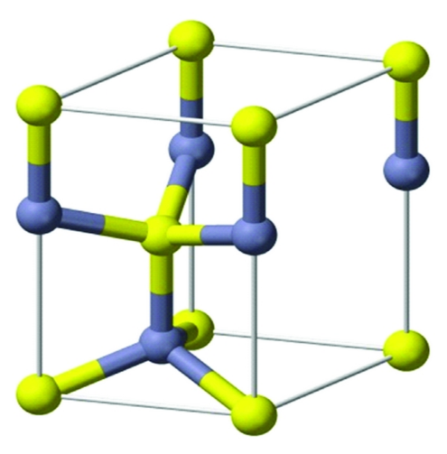
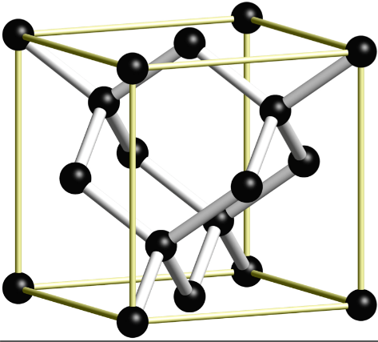
Let’s design a class for a crystal structure
What kind of properties would you like to store?
What kind of actions would you like to perform?
variables
functions
Notes:
Guide the class a little bit more with the attributes and such
e.g., point out the difference between zincblende and wurtzite

Slide 25
Object Oriented Programming
Bank Account
Properties
Person: Object
Account Balance: Float
Account type (Checking/Saving): String
Functions
Add Funds
Withdraw Funds
Check Balance
https://www.geeksforgeeks.org/python-program-to-create-bankaccount-class-with-deposit-withdraw-function/
Person
Properties
Name: String
Address: String
Birthday: Date
Social Security Number: String
Password: String
Etc.
Functions
Change Address
Change Password

Slide 26
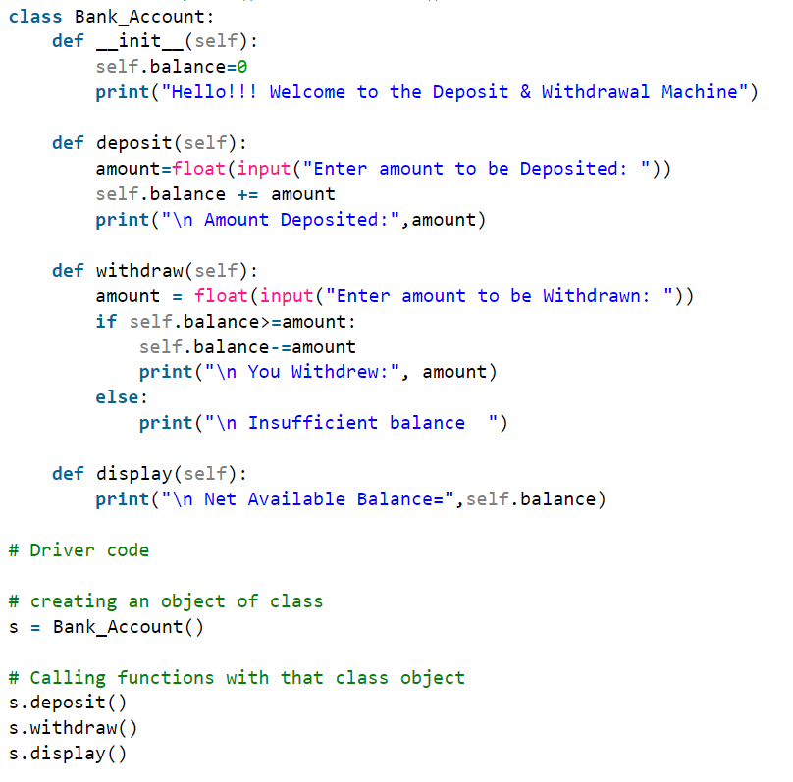

Slide 27
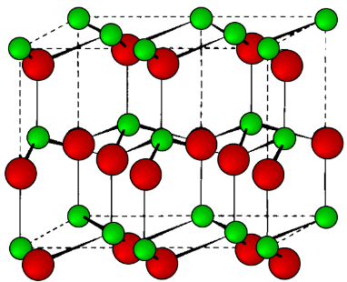
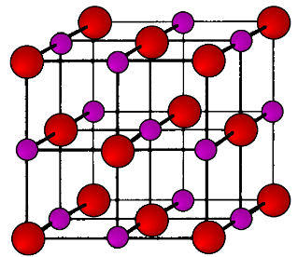
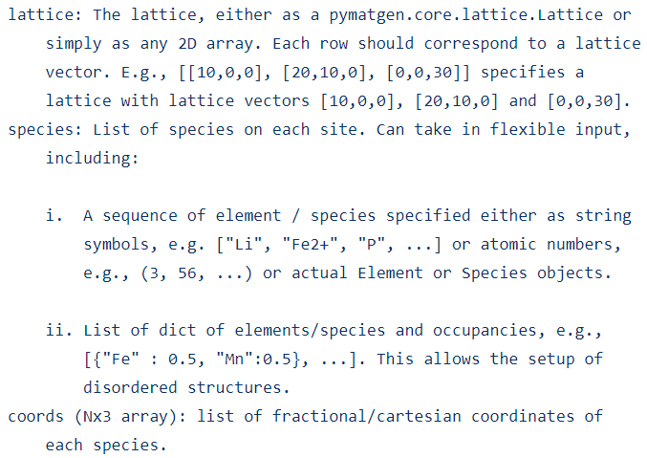

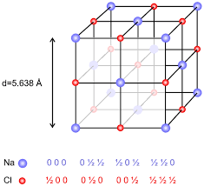
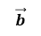

Structure Class
from pymatgen.core.structure import Structure
s = Structure(Lattice, Species, Coords)
lattice:
Lattice
$$\vec{a}$$
$$\vec{b}$$
species:
Species (elements/molecules, occupancies)
Fractional Coordinates
Coords(Nx3 array):

Slide 28

Structure Class
Contains:
Lattice – Set of lattice vectors
Species – List of species on each lattice site
Coords – List of fractional/cartesian coordinates for each species
Examples of Structure Class Methods:
self.lattice()
self.append()
self.insert()
self.remove_sites()
self.translate_sites()
self.rotate_sites()
self.apply_strain()
self.calculate()
self.relax()
Perform a calculation
Modify the structure

Slide 29







Lattice class
Lattice = set of translation vectors to generate infinite periodic lattice
$$\vec{a}$$
$$\vec{b}$$
Examples of Lattice Subclass Methods:
self.lengths()
self.angles()
self.reciprocal_lattice()
self.inv_matrix()
Return lattice properties
self.get_wigner_seitz_cell()
self.get_brillouin_zone()
self.get_miller_indices_from_coords()
$$T=\left[\left[\begin{matrix}a_{1} \\ a_{2}\end{matrix}\right]\left[\begin{matrix}b_{1} \\ b_{2}\end{matrix}\right]\right]$$
self.scale()
Modify the lattice
Perform a calculation
2D lattice vectors
Notes:
An Animal object can be an attribute for a Zoo_area object
Similarly, a Lattice object can be an attribute for a Structure object

Slide 30

Pymatgen is always changing and growing.
There is no great documentation, except the source code on Github
Explore it based on your MSE intuition. Start with core and analysis

Slide 31



Professor Kioupakis asked me:
“I hypothesize that ionic oxides with high atomic density will have strong overlap of atomic orbitals, which will be correlated with a larger band gap.”
How might we explore this?

Slide 32


Slide 33
Preparation for tomorrow:
Download and Install Anaconda
https://www.anaconda.com/
Install Pymatgen
Open Anaconda Prompt:
Type: “conda install -c conda-forge pymatgen”
Open Anaconda Navigator
Install Jupyter Notebook
Try a few of the commands on the following page to see if Pymatgen is working properly:

Slide 34


